Slide 1
CAN Bit Segmentation
AGENDA
Bit Monitoring
Can Bit segmentation
Synch Segment
Propagation Segment
Phase 1 and 2 Segments
Visualizing Propagation delays
Shyam Bhat
VicharaVandana

Slide 2
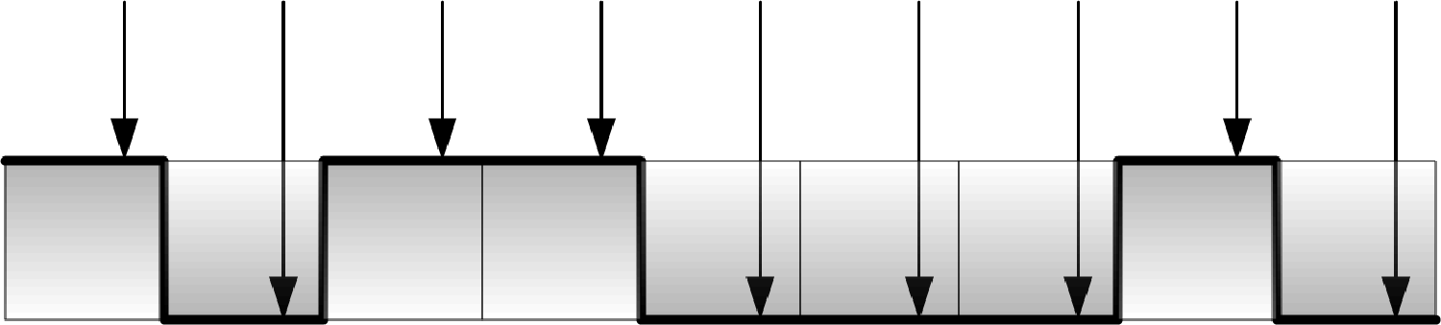
Bit Monitoring
Bit Monitoring: Monitoring the bus for bit value. (Sampling)
Tx node first puts the bit value on bus and then monitors if bus has taken that value properly
Rx nodes samples the bus and reads the bit value
What point of time in bit value does sampling happen? → Bit Segments

Slide 3
CAN Bit Segments

Slide 4
Propagation Delay

Slide 5
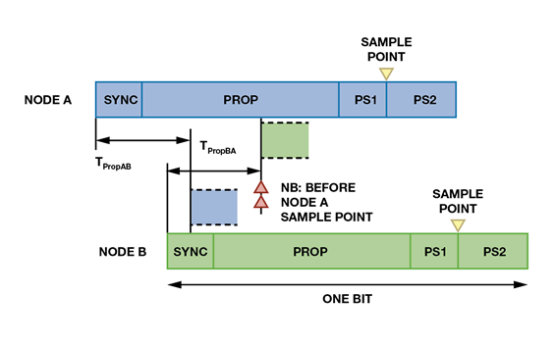
Visualizing Propagation delays

Slide 6
Points to Remember
Every Tx node monitors the bus after it transmits the bit value to check for successful Tx
Every CAN bit is divided into 4 segments:
Synchronization segment
Propagation segment
Phase segment 1
Phase segment 2
Bit transmission happens during Sync segment and monitoring happens after phase 1
Propagation segment compensates for propagation delays on the bus
Transmission of bit and propagation must be over for all nodes on bus before the bit sampling has to happen to ensure all the nodes read the same value for a bit on the bus.

